Slide 1
Chapter 4 The Simplex Algorithm and Goal Programming
to accompany
Operations Research: Applications and Algorithms
4th edition
by Wayne L. Winston
Copyright (c) 2004 Brooks/Cole, a division of Thomson Learning, Inc.

Slide 2
4.1 How to Convert an LP to Standard Form
Before the simplex algorithm can be used to solve an LP, the LP must be converted into a problem where all the constraints are equations and all variables are nonnegative.
An LP in this form is said to be in standard form.

Slide 3
Example 1: Leather Limited
Leather Limited manufactures two types of leather belts: the deluxe model and the regular model.
Each type requires 1 square yard of leather.
A regular belt requires 1 hour of skilled labor and a deluxe belt requires 2 hours of skilled labor.
Each week, 40 square yards of leather and 60 hours of skilled labor are available.
Each regular belt contributes $3 profit and each deluxe belt $4.
Write an LP to maximize profit.

Slide 4
Example 1: Solution
The decision variables are:
x1 = number of deluxe belts produced weekly
x2 = number of regular belts produced weekly
The appropriate LP is:
max z = 4x₁ + 3x₂
s.t. x₁ + x₂ ≤ 40 (leather constraint)
2x₁ +x₂ ≤ 60 (labor constraint)
x₁, x₂ ≥ 0

Slide 5
To convert a ≤ constraint to an equality, define for each constraint a slack variable s_{i} (s_{i} = slack variable for the ith constraint). A slack variable is the amount of the resource unused in the ith constraint.
If a constraint i of an LP is a ≤ constraint, convert it to an equality constraint by adding a slack variable s_{i} to the ith constraint and adding the sign restriction s_{i} ≥ 0.

Slide 6
To convert the ith ≥ constraint to an equality constraint, define an excess variable (sometimes called a surplus variable) e_{i} (e_{i} will always be the excess variable for the ith ≥ constraint.
We define e_{i} to be the amount by which ith constraint is over satisfied.
Subtracting the excess variable e_{i} from the ith constraint and adding the sign restriction e_{i} ≥ 0 will convert the constraint.
If an LP has both ≤ and ≥ constraints, apply the previous procedures to the individual constraints.

Slide 7
4.2 Preview of the Simplex Algorithm
Consider a system Ax = b of m linear equations in n variables (where n ≥ m).
A basic solution to Ax = b is obtained by setting n – m variables equal to 0 and solving for the remaining m variables.
This assumes that setting the n – m variables equal to 0 yields a unique value for the remaining m variables, or equivalently, the columns for the remaining m variables are linearly independent.
Any basic solution in which all variables are nonnegative is called a basic feasible solution (or bfs).

Slide 8
The following theorem explains why the concept of a basic feasible solution is of great importance in linear programming.
Theorem 1 The feasible region for any linear programming problem is a convex set. Also, if an LP has an optimal solution, there must be an extreme point of the feasible region that is optimal.

Slide 9
4.3 Direction of Unboundedness
Consider an LP in standard form with feasible region S and constraints Ax=b and x ≥ 0. Assuming that our LP has n variables, 0 represents an n-dimensional column vector consisting of all 0’s.
A non-zero vector d is a direction of unboundedness if for all x∈S and any c≥0, x +cd∈S

Slide 10
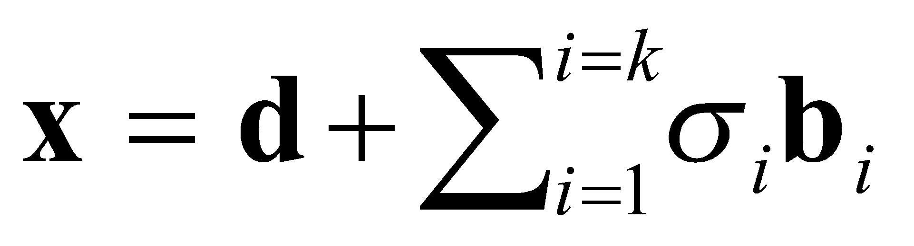
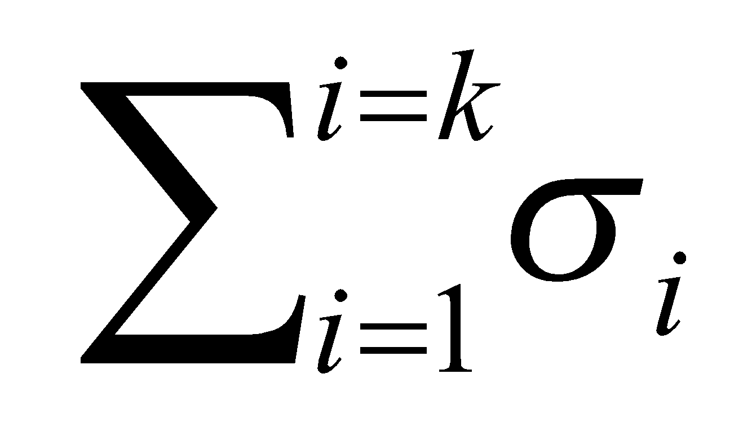
Theorem 2 Consider an LP in standard form, having bfs b₁, b₂,…b_{k}. Any point x in the LP’s feasible region may be written in the form where d is 0 or a direction of unboundedness and =1 and σ_{i} ≥ 0.
Any feasible x may be written as a convex combination of the LP’s bfs.

Slide 11

4.4 Why Does LP Have an Optimal bfs?
Theorem 3 If an LP has an optimal solution, then it has an optimal bfs.
For any LP with m constraints, two basic feasible solutions are said to be adjacent if their sets of basic variables have m – 1 basic variables in common.
The set of points satisfying a linear inequality in three (or any number of) dimensions is a half-space.
The intersection of half-space is called a polyhedron.

Slide 12
4.5 The Simplex Algorithm
The simplex algorithm can be used to solve LPs in which the goal is to maximize the objective function.
Step 1 Convert the LP to standard form
Step 2 Obtain a bfs (if possible) from the standard form
Step 3 Determine whether the current bfs is optimal
Step 4 If the current bfs is not optimal, determine which nonbasic variable should become a basic variable and which basic variable should become a nonbasic variable to find a bfs with a better objective function value.
Step 5 Use EROs to find a new bfs with a better objective function value. Go back to Step 3.

Slide 13
Example 2: Dakota Furniture Company
The Dakota Furniture company manufactures desk, tables, and chairs.
The manufacture of each type of furniture requires lumber and two types of skilled labor: finishing and carpentry.
The amount of each resource needed to make each type of furniture is given in the table below.
Resource | Desk | Table | Chair
Lumber | 8 board ft | 6 board ft | 1 board ft
Finishing hours | 4 hours | 2 hours | 1.5 hours
Carpentry hours | 2 hours | 1.5 hours | 0.5 hours

Slide 14
Ex. 2 - continued
At present, 48 board feet of lumber, 20 finishing hours, 8 carpentry hours are available. A desk sells for $60, a table for $30, and a chair for $ 20.
Dakota believes that demand for desks and chairs is unlimited, but at most 5 tables can be sold.
Since the available resources have already been purchased, Dakota wants to maximize total revenue.

Slide 15
Example 2: Solution
Define:
x1 = number of desks produced
x2 = number of tables produced
x3 = number of chairs produced
The LP is:
max z = 60x₁ + 30x₂ + 20x₃
s.t. 8x₁ + 6x₂ + x₃ ≤ 48 (lumber constraint)
4x₁ + 2x₂ + 1.5x3 ≤ 20 (finishing constraint)
2x₁ + 1.5x₂ + 0.5x₃ ≤ 8 (carpentry constraint)
x₂ ≤ 5 (table demand constraint)
x₁, x₂, x₃ ≥ 0

Slide 16
Ex. 2: Solution continued
Begin the simplex algorithm by converting the constraints of the LP to the standard form.
Then convert the LP’s objective function to the row 0 format.
To put the constraints in standard form, simply add slack variables s₁, s₂, s₃, s₄, respectively to the four constraints.
Label the constraints row 1, row 2, row 3, row 4, and add the sign restrictions si ≥ 0.

Slide 17
Ex. 2: Solution continued
Putting rows 1-4 together in row 0 and the sign restrictions yields these equations and basic variables.
 | Canonical Form 0 |  | Basic Variable
Row 0 | z – 60x₁ – 30x₂ – 20x₃ | = 0 | z = 0
Row 1 | 8x₁ + 6x₂ + x₃ + s₁ | = 48 | s₁ = 48
Row 2 | 4x₁ + 2x₂ + 1.5x₃ + s₂ | = 20 | s₂ = 20
Row 3 | 2x₁ + 1.5x₂ + 0.5x₃ + s₃ | = 8 | s₃ = 8
Row 4 | x₂ + s₄ | = 5 | s₄ = 5

Slide 18
Ex. 2: Solution continued
To perform the simplex algorithm, we need a basic (although not necessarily nonnegative) variable for row 0.
Since z appears in row 0 with a coefficient of 1, and z does not appear in any other row, we use z as the basic variable.
With this convention, the basic feasible solution for our initial canonical form has
BV = {z, s₁, s₂, s₃, s₄}
NBV = {x₁, x₂, x₃}.
For this initial bfs, z=0, s₁=48, s₂= 20, s₃=8, s₄=5, x₁=x₂=x₃=0.
A slack variable can be used as a basic variable if the rhs of the constraint is nonnegative.

Slide 19
Ex. 2: Solution continued
Once we have obtained a bfs, we need to determine whether it is optimal.
To do this, we try to determine if there is any way z can be increased by increasing some nonbasic variable from its current value of zero while holding all other nonbasic variables at their current values of zero.
Solving for z in row 0 yields: Z = 60x₁ + 30x₂ + 20x₃

Slide 20
Ex. 2: Solution continued
For each nonbasic variable, we can use this equation to determine if increasing a nonbasic variable will increase z.
Increasing any of the nonbasic variables will cause an increase in z.
However increasing x₁ causes the greatest rate of increase in z. If x₁ increases from its current value of zero, it will have to become a basic variable.
For this reason, x₁ is called the entering variable. Observe x₁ has the most negative coefficient in row 0.

Slide 21
Ex. 2: Solution continued
Next choose the entering variable to be the nonbasic variable with the most negative coefficient in row 0.
Goal is to make x₁ as large as possible but as it increases, the current basic variables will change value. Thus, increasing x₁ may cause a basic variable to become negative.
This means to keep all the basic variables nonnegative, the largest we can make x₁ is min {6, 5, 4} = 4.

Slide 22
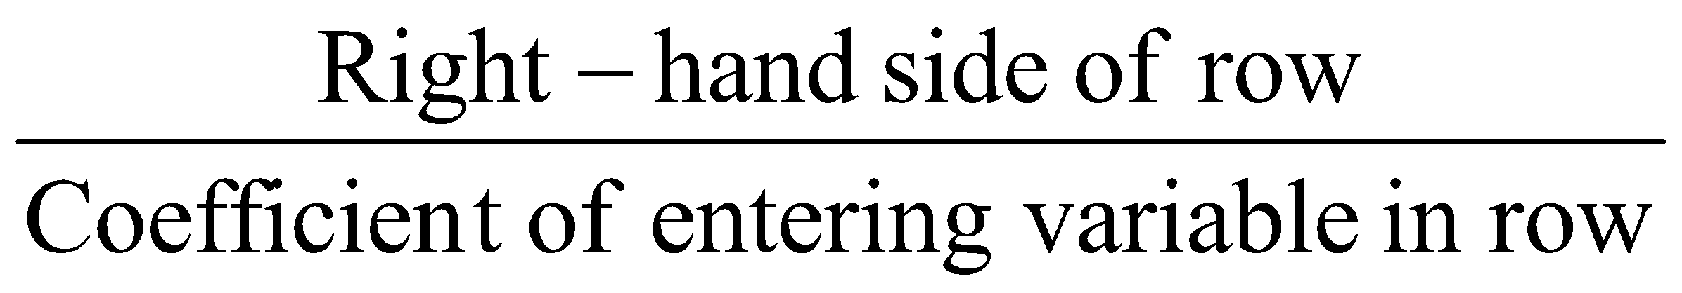
Ex. 2: Solution continued
Rule for determining how large an entering variable can be.
When entering a variable into the basis, compute the ratio for every constraint in which the entering variable has a positive coefficient.
The constraint with the smallest ratio is called the winner of the ratio test.
The smallest ratio is the largest value of the entering variable that will keep all the current basic variables nonnegative.

Slide 23
Ex. 2: Solution continued
Always make the entering variable a basic variable in a row that wins the ratio test.
To make x₁ a basic variable in row 3, we use elementary row operations (EROs) to make x₁ have a coefficient of 1 in row 3 and a coefficient of 0 in all other rows.
This procedure is called pivoting on row 3; and row 3 is called the pivot row.
The final result is that x₁ replaces s₃ as the basic variable for row 3. The term in the pivot row that involves the entering basic variable is called the pivot term.

Slide 24
Ex. 2: Solution continued
The result is
The procedure used to go from one bfs to a better adjacent bfs is called an iteration of the simplex algorithm.
 | Canonical Form 1 |  | Basic Variable
Row 0 | z + 15x₂ - 5x₃ + 30s₃ | = 240 | z = 240
Row 1 | - x₃ + s₁ - 4s₃ | = 16 | s₁ = 16
Row 2 | - x₂ + 0.5 x₃ + s₂ - 2 s₃ | = 4 | s₂ = 4
Row 3 | x₁ + 0.75x₂ + 0.25x₃ + 0.5s₃ | = 4 | x₁ = 4
Row 4 | x₂ + s₄ | = 5 | s₄ = 5

Slide 25
Ex. 2: Solution continued
Attempt to determine if the current bfs is optimal.
Rearranging row 0 from Canonical Form 1, and solving for z yields z = 240 – 15x₂ +5x₃ -30s₃
The current bfs is NOT optimal because increasing x₃ to 1 (while holding the other nonbasic variable to zero) will increase the value of z.
Making either x₂ or s₃ basic will cause the value of z to decrease.

Slide 26
Ex. 2: Solution continued
Recall the rule for determining the entering variable is the row 0 coefficient with the greatest negative value.
Since x₃ is the only variable with a negative coefficient, x₃ should be entered into the basis.
Performing the ratio test using x₃ as the entering variable yields the following results (holding other NBVs to zero):
From row 1, s1 ≥ 0 for all values of x3 since s1 = 16 + x3
From row 2, s2 ≥ 0 if x3 > 4 / 0.5 = 8
From row 3, x1 ≥ 0 if x3 >4 / 0.25 = 16
From row 4, s4 ≥ 0 for all values of x3 since s4 = 5

Slide 27
Ex. 2: Solution continued
This means to keep all the basic variables nonnegative, the largest we can make x₁ is min {8,16} = 8. So, row 2 becomes the pivot row.
The result of using EROs, to make x₃ a basic variable in row 2.
 | Canonical Form 2 |  | Basic Variable
Row 0 | z + 5x₂ + 10s₂ + 10s₃ | = 280 | z = 280
Row 1 | - 2x₂ + s₁ + 2s₂ - 8s₃ | = 24 | s₁ = 24
Row 2 | - 2x₂ + x₃ + 2s₂ - 4s₃ | = 8 | x₃ = 8
Row 3 | x₁ + 1.25x₂ - 0.5 s₂ + 1.5s₃ | = 2 | x₁ = 2
Row 4 | x₂ + s₄ | = 5 | s₄ = 5

Slide 28
Ex. 2: Solution continued
In Canonical Form 2
BV = {z, s₁, x₃, x₁, s₄}
NBV = {s₃, s₂, x₂ }
Yielding the bfs z = 280, s₁=24, x₃=8, x₁=2, s₄=5, s₂=s₃=x₂=0
Solving for z in row 0 yields z = 280 - 5x₂ - 10s₂ -10s₃
We can see that increasing x₂, s₂, or s₃ (while holding the other NBVs to zero) will not cause the value of z to increase.

Slide 29
Ex. 2: Solution continued
The solution at the end of iteration 2 is therefore optimal. The following rule can be applied to determine whether a canonical form’s bfs is optimal.
A canonical form is optimal (for a max problem) if each nonbasic variable has a nonnegative coefficient in the canonical form’s row 0.

Slide 30
4.6 Using the Simplex Algorithm to solve Minimization Problems
Two different ways the simplex method can be used to solve minimization problems.
Method 1 - Consider this LP
The optimal solution is the point (x₁,x₂) that makes z = 2x₁ – 3x₂ the smallest.
Equivalently, this point makes max -z = - 2x₁ + 3x₂ the largest.
min z = 2x₁ – 3x₂
s.t. x₁ + x₂ ≤ 4
x₁ – x₂ ≤ 6
x₁, x₂ ≥ 0

Slide 31
This means we can find the optimal solution to the LP by solving this modified LP.
In solving this modified LP, use –z as the basic variable in row 0. After adding slack variables, s₁ and s₂ to the constraints the initial tableau s obtained.
max -z = -2x₁ + 3x₂
s.t. x₁ + x₂ ≤ 4
x₁ – x₂ ≤ 6
x₁, x₂ ≥ 0

Slide 32
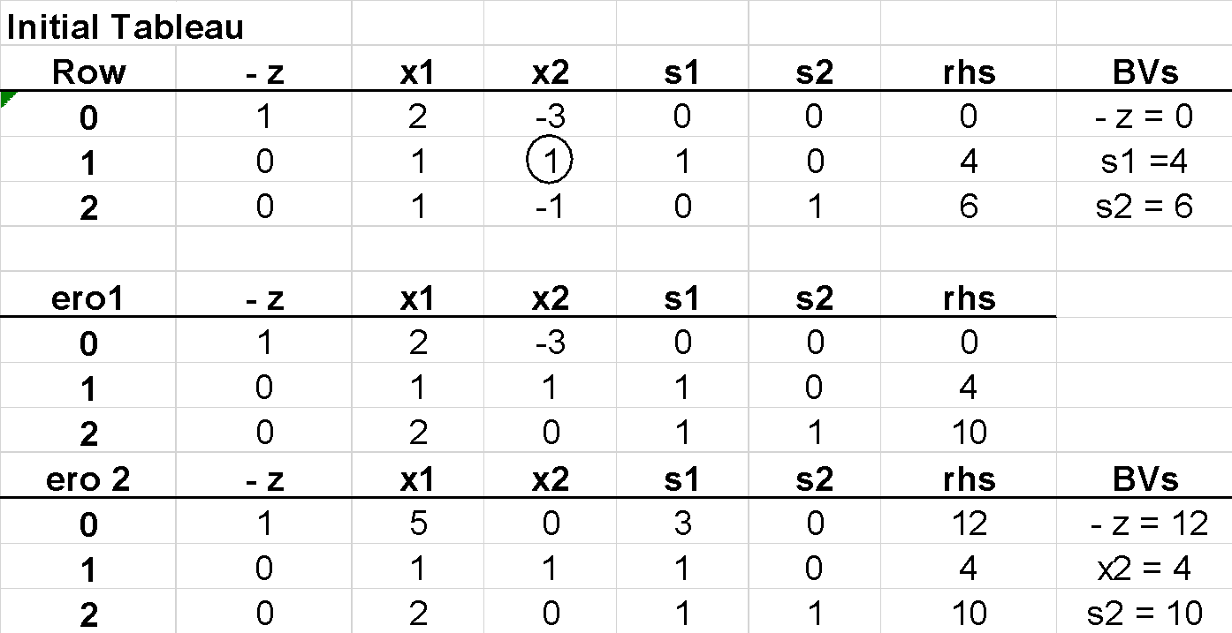
The optimal solution (to the max problem) is -z = 12, x₂=4, s₂=10, x₁=s₁=0.
Then the optimal solution to the min problem is z = -12, x₂=4, s₂ = 10, x₁=s₁=0.
The min LP objective function confirms this: z =2x₁-3x₂=2(0)–3(4)= -12.

Slide 33
In summary, multiply the objective function for the min problem by -1 and solve the problem as a maximization problem with the objective function –z.
The optimal solution to the max problem will give you the optimal solution for to the min problem.
Remember that (optimal z-value for the min problem) = - (optimal z-value for the max problem).

Slide 34
Method 2 - A simple modification of the simplex algorithm can be used to solve min problems directly.
Modify step 3 of the simplex algorithm
If all nonbasic variables (NBV) in row 0 have nonpositive coefficients, the current bfs is optimal.
If any nonbasic variable has a positive coefficient, choose the variable with the “most positive” coefficient in row 0 as the entering variable.
This modification of the simplex algorithm works because increasing a nonbasic variable (NBV) with a positive coefficient in row 0 will decrease z.

Slide 35
min z = 2x₁ - 3x₂
s.t. x₁ + x₂ ≤ 4
x₁ – x₂ ≤ 6
x₁, x₂ ≥ 0

Slide 36
4.7 Alternate Optimal Solutions
For some LPs, more than one extreme point is optimal. If an LP has more than one optimal solution, it has multiple optimal solutions or alternative optimal solutions.
If there is no nonbasic variable (NBV) with a zero coefficient in row 0 of the optimal tableau, the LP has a unique optimal solution.
Even if there is a nonbasic variable with a zero coefficient in row 0 of the optimal tableau, it is possible that the LP may not have alternative optimal solutions.

Slide 37
 | Canonical Form 0 |  | Basic Variable
Row 0 | z – 60x₁ – 35x₂ – 20x₃ | = 0 | z = 0
Row 1 | 8x₁ + 6x₂ + x₃ + s₁ | = 48 | s₁ = 48
Row 2 | 4x₁ + 2x₂ + 1.5x₃ + s₂ | = 20 | s₂ = 20
Row 3 | 2x₁ + 1.5x₂ + 0.5x₃ + s₃ | = 8 | s₃ = 8
Row 4 | x₂ + s₄ | = 5 | s₄ = 5

Slide 38
4.8 – Unbounded LPs
For some LPs, there exist points in the feasible region for which z assumes arbitrarily large (in max problems) or arbitrarily small (in min problems) values. When this occurs, we say the LP is unbounded.
An unbounded LP occurs in a max problem if there is a nonbasic variable with a negative coefficient in row 0 and there is no constraint that limits how large we can make this NBV.
Specifically, an unbounded LP for a max problem occurs when a variable with a negative coefficient in row 0 has a non positive coefficient in each constraint.

Slide 39
Unbounded LP – Max Problem
Initial tableau
z | x₁ | x₂ | x₃ | x₄ | s₁ | s₂ | rhs | BV | Ratio
1 | -36 | -30 | 3 | 4 | 0 | 0 | 0 | z
0 | 1 | 1 | -1 | 0 | 1 | 0 | 5 | s₁ | 5
0 | 6 | 5 | 0 | -1 | 0 | 1 | 10 | s₂ | 5/3
First tableau
z | x₁ | x₂ | x₃ | x₄ | s₁ | s₂ | rhs | BV | Ratio
1 | 0 | 0 | 3 | -2 | 0 | 6 | 60 | z
0 | 0 | 1/6 | -1 | 1/6 | 1 | -1/6 | 10/3 | s₁ | 20
0 | 1 | 5/6 | 0 | -1/6 | 0 | 1/6 | 5/3 | x₁ | None
Second tableau
z | x₁ | x₂ | x₃ | x₄ | s₁ | s₂ | rhs | BV | Ratio
1 | 0 | 2 | -9 | 0 | 12 | 4 | 100 | z
0 | 0 | 1 | -6 | 1 | 6 | -1 | 20 | x₄ | None
0 | 1 | 1 | -1 | 0 | 1 | 0 | 5 | x₁ | None

Slide 40
4.11 Degeneracy and the Convergence of the Simplex Algorithm
Theoretically, the simplex algorithm can fail to find an optimal solution to an LP.
However, LPs arising from actual applications seldom exhibit this unpleasant behavior.
The following are facts:
If (value of entering variable in new bfs) > 0, then (z-value for new bfs) > (z-value for current bfs).
If (value of entering variable in new bfs) = 0, then (z-value for new bfs) = (z-value for current bfs).
Assume that in each of the LP’s basic feasible solutions all basic variables are positive.

Slide 41
An LP with this property is a nondegenerate LP.
An LP is degenerate if it has at least one bfs in which a basic variable is equal to zero.
Any bfs that has at least one basic variable equal to zero is a degenerate bfs.
When the same bfs is encountered twice it is called cycling.
If cycling occurs, then we will loop, or cycle, forever among a set of basic feasible solutions and never get to an optimal solution.

Slide 42
Some degenerate LPs have a special structure that enables us to solve them by methods other than the simplex.

Slide 43
max z = 5x₁ + 2x₂
s.t. x₁ + x₂ ≤ 6
x₁ – x₂ ≤ 0
x₁, x₂ ≥ 0

Slide 44
4.12 The Big M Method
The simplex method algorithm requires a starting bfs.
Previous problems have found starting bfs by using the slack variables as our basic variables.
If an LP have ≥ or = constraints, however, a starting bfs may not be readily apparent.
In such a case, the Big M method may be used to solve the problem.

Slide 45
Example 4: Bevco
Bevco manufactures an orange-flavored soft drink called Oranj by combining orange soda and orange juice.
Each ounce of orange soda contains 0.5 oz of sugar and 1 mg of vitamin C.
Each ounce of orange juice contains 0.25 oz of sugar and 3 mg of vitamin C.
It costs Bevco 2¢ to produce an ounce of orange soda and 3¢ to produce an ounce of orange juice.
Bevco’s marketing department has decided that each 10-oz bottle of Oranj must contain at least 20 mg of vitamin C and at most 4 oz of sugar.
Use linear programming to determine how Bevco can meet the marketing department’s requirements at minimum cost.

Slide 46
Example 4: Bevco
Each ounce of orange soda contains 0.5 oz of sugar and 1 mg of vitamin C.
Each ounce of orange juice contains 0.25 oz of sugar and 3 mg of vitamin C.
It costs Bevco 2¢ to produce an ounce of orange soda and 3¢ to produce an ounce of orange juice.
Bevco’s marketing department has decided that each 10-oz bottle of Oranj must contain at least 20 mg of vitamin C and at most 4 oz of sugar.

Slide 47
Example 4: Solution
Letting x₁ = number of ounces of orange soda in a bottle of Oranj
x2 = number of ounces of orange juice in a bottle of Oranj
The LP is:
min z = 2x₁ + 3x₂
st 0.5x₁ + 0.25x₂ ≤ 4 (sugar constraint)
x₁ + 3x₂ ≥ 20 (Vitamin C constraint)
x₁ + x₂ = 10 (10 oz in 1 bottle of Oranj)
x₁, x₂ ≥ 0

Slide 48
Ex. 4 – Solution continued
The LP in standard form has z and s₁ which could be used for BVs but row 2 would violate sign restrictions and row 3 no readily apparent basic variable.
In order to use the simplex method, a bfs is needed.
To remedy the predicament, artificial variables are created.
The variables will be labeled according to the row in which they are used.
Row 0: z - 2x₁ - 3x₂ = 0
Row 1: 0.5x₁ + 0.25x₂ + s₁ = 4
Row 2: x₁ + 3x₂ - e₂ = 20
Row 3: x₁ + x₂ = 10

Slide 49
Ex. 4 – Solution continued
Row 0: z - 2x₁ - 3x₂ = 0
Row 1: 0.5x₁ + 0.25x₂ + s₁ = 4
Row 2: x₁ + 3x₂ - e₂ + a₂ = 20
Row 3: x₁ + x₂ + a₃ = 10
In the optimal solution, all artificial variables must be set equal to zero.
To accomplish this, in a min LP, a term Ma_{i} is added to the objective function for each artificial variable a_{i}.
For a max LP, the term –Ma_{i} is added to the objective function for each a_{i}.
M represents some very large number.

Slide 50
Ex. 4 – Solution continued
The modified Bevco LP in standard form then becomes:
Modifying the objective function this way makes it extremely costly for an artificial variable to be positive. The optimal solution should force a₂ = a₃ =0.
Row 0: z - 2x₁ - 3x₂ -Ma₂ - Ma₃ = 0
Row 1: 0.5x₁ + 0.25x₂ + s₁ = 4
Row 2: x₁ + 3x₂ - e₂ + a₂ = 20
Row 3: x₁ + x₂ + a₃ = 10

Slide 51
Description of the Big M Method
Modify the constraints so that the rhs of each constraint is nonnegative. Identify each constraint that is now an = or ≥ constraint.
Convert each inequality constraint to standard form (add a slack variable for ≤ constraints, add an excess variable for ≥ constraints).
For each ≥ or = constraint, add artificial variables. Add sign restriction a_{i} ≥ 0.
Let M denote a very large positive number. Add (for each artificial variable) Ma_{i} to min problem objective functions or -Ma_{i} to max problem objective functions.

Slide 52
Since each artificial variable will be in the starting basis, all artificial variables must be eliminated from row 0 before beginning the simplex. Remembering M represents a very large number, solve the transformed problem by the simplex.
If all artificial variables in the optimal solution equal zero, the solution is optimal.
If any artificial variables are positive in the optimal solution, the problem is infeasible.

Slide 53
Ex. 4 – Solution continued
The modified Bevco LP in standard form then becomes:
Row 0: z - 2x₁ - 3x₂ -Ma₂ - Ma₃ = 0
Row 1: 0.5x₁ + 0.25x₂ + s₁ = 4
Row 2: x₁ + 3x₂ - e₂ + a₂ = 20
Row 3: x₁ + x₂ + a₃ = 10

Slide 54
Eliminate a₂ and a₃ from row 0
Row 0 : z - 2x₁ - 3x₂ -Ma₂ - Ma₃ = 0
M(row 2): Mx₁ + 3Mx₂ - Me₂ +Ma₂ = 20M
M(row 3): Mx₁ + Mx₂ +Ma₃ = 10M
New row 0: z + (2M – 2) x₁ + (4M – 3)x₂ -Me₂ = 30M

Slide 55
Ex. 4 – Solution continued
Row 0: z + (2M – 2) x₁ + (4M – 3)x₂ -Me₂ = 30M
Row 1: 0.5x₁ + 0.25x₂ + s₁ = 4
Row 2: x₁ + 3x₂ - e₂ + a₂ = 20
Row 3: x₁ + x₂ + a₃ = 10
Initial Tableau
z | x₁ | x₂ | s₁ | e₂ | a₂ | a₃ | rhs | BV

Slide 56
Ex. 4 – Solution continued
Initial Tableau
z | x₁ | x₂ | s₁ | e₂ | a₂ | a₃ | rhs | BV

Slide 57
Ex. 4 – Solution continued
First Tableau
z | x₁ | x₂ | s₁ | e₂ | a₂ | a₃ | rhs | BV

Slide 58
Ex. 4 – Solution continued
Second Tableau
z | x₁ | x₂ | s₁ | e₂ | a₂ | a₃ | rhs | BV

Slide 59
Example 4: Solution
Letting x₁ = number of ounces of orange soda in a bottle of Oranj
x2 = number of ounces of orange juice in a bottle of Oranj
The LP is:
min z = 2x₁ + 3x₂
st 0.5x₁ + 0.25x₂ ≤ 4 (sugar constraint)
x₁ + 3x₂ ≥ 36 (Vitamin C constraint)
x₁ + x₂ = 10 (10 oz in 1 bottle of Oranj)
x₁, x₂ ≥ 0

Slide 60
Ex. 4 – Solution continued
The modified Bevco LP in standard form then becomes:
Row 0: z - 2x₁ - 3x₂ -Ma₂ - Ma₃ = 0
Row 1: 0.5x₁ + 0.25x₂ + s₁ = 4
Row 2: x₁ + 3x₂ - e₂ + a₂ = 36
Row 3: x₁ + x₂ + a₃ = 10

Slide 61
Eliminate a₂ and a₃ from row 0
Row 0 : z - 2x₁ - 3x₂ -Ma₂ - Ma₃ = 0
M(row 2): Mx₁ + 3Mx₂ - Me₂ +Ma₂ = 36M
M(row 3): Mx₁ + Mx₂ +Ma₃ = 10M
New row 0: z + (2M – 2) x₁ + (4M – 3)x₂ -Me₂ = 46M

Slide 62
Ex. 4 – Solution continued
Row 0: z + (2M – 2) x₁ + (4M – 3)x₂ -Me₂ = 46M
Row 1: 0.5x₁ + 0.25x₂ + s₁ = 4
Row 2: x₁ + 3x₂ - e₂ + a₂ = 36
Row 3: x₁ + x₂ + a₃ = 10
Initial Tableau
z | x₁ | x₂ | s₁ | e₂ | a₂ | a₃ | rhs | BV

Slide 63
Ex. 4 – Solution continued
Initial Tableau
z | x₁ | x₂ | s₁ | e₂ | a₂ | a₃ | rhs | BV

Slide 64
Ex. 4 – Solution continued
First Tableau
z | x₁ | x₂ | s₁ | e₂ | a₂ | a₃ | rhs | BV

Slide 65
4.13 The Two-Phase Simplex Method
When a basic feasible solution is not readily available, the two-phase simplex method may be used as an alternative to the Big M method.
In this method, artificial variables are added to the same constraints, then a bfs to the original LP is found by solving Phase I LP.
In Phase I LP, the objective function is to minimize the sum of all artificial variables.
At completion, reintroduce the original LP’s objective function and determine the optimal solution to the original LP.

Slide 66
Because each a_{i} ≥ 0, solving the Phase I LP will result in one of the following three cases:
The optimal value of w’ is greater than zero.
The optimal value of w’ is equal to zero, and no artificial variables are in the optimal Phase I basis.
In this case, drop all columns in the optimal Phase I tableau that correspond to the artificial variables.
Now combine the original objective function with the constraints from the optimal Phase I tableau.
This yields the Phase II LP.
The optimal value of w’ is equal to zero and at least one artificial variable is in the optimal Phase I basis.

Slide 67
Two-Phase Simplex: Case 2
min z = 2x₁ + 3x₂
st 0.5x₁ + 0.25x₂ ≤ 4 (sugar constraint)
x₁ + 3x₂ ≥ 20 (Vitamin C constraint)
x₁ + x₂ = 10 (10 oz in 1 bottle of Oranj)
x₁, x₂ ≥ 0

Slide 68
w' | x₁ | x₂ | s₁ | e₂ | a₂ | a₃ | rhs | BV

Slide 69
4.14 Unrestricted-in-Sign Variables
If some variables are allowed to be unrestricted in sign (urs), the ratio test and therefore the simplex algorithm are no longer valid.
An LP with an unrestricted-in-sign variable can be transformed into an LP in which all variables are required to be non-negative.
For each urs variable, define two new variables x’_{i} and x’’_{i}.
Then substitute x’_{i} - x’’_{i} for xi in each constraint and in the objective function. Also add the sign restrictions.

Slide 70
The effect of this substitution is to express xi as the difference of the two nonnegative variables x’_{i} and x’’_{i}.
No basic feasible solution can have both x’_{i} ≥ 0 and x’’_{i} ≥ 0.
For any basic feasible solution, each urs variable x_{i} must fall into one of the following three cases.
x’_{i} > 0 and x’’_{i} = 0
x’_{i} = 0 and x’’_{i} > 0
x’_{i} = x’’_{i} = 0

Slide 71
A baker has 30 oz of flour and 5 packages of yeast. Baking a loaf of bread requires 5 oz of flour and 1 package of yeast. Each loaf of bread can be sold for 30c. The baker may purchase additional flour at 4c/oz or sell leftover flour at the same price.

